Slide 1


For RDS Knowledge Base
-POWERED BY GEN AI

Slide 2
Product Brief:
RDS Knowledge Base integrated Conversational RAG Assistant
What It Is: A Gen AI-powered support assistant that retrieves and answers user questions by understanding and extracting relevant information from documents stored in Confluence.
Automated Sync: Downloads latest attachments (PDF, DOCX, XLSX) from Confluence pages using REST API
Smart Document Parsing: Extracts and chunks content into semantically meaningful pieces
Vector Embedding + Storage: Converts chunks into vector embeddings using OpenAI and stores them in ChromaDB for efficient semantic search
Interactive Chat UI: Built with Streamlit, allowing real-time Q&A with users
Context-Aware Retrieval: Uses LangChain to track chat history and provide intelligent responses using GPT-4.1-mini
Why This Product Matters:
Saves Time: No more manual document digging—just ask and get the answer instantly
Improves Support Efficiency: Quickly resolves queries based on internal documentation
Scales Easily: Works for technical support, onboarding, release documentation, and more
Secure & Private: Can be run locally using environment-protected keys and data storage

Slide 3

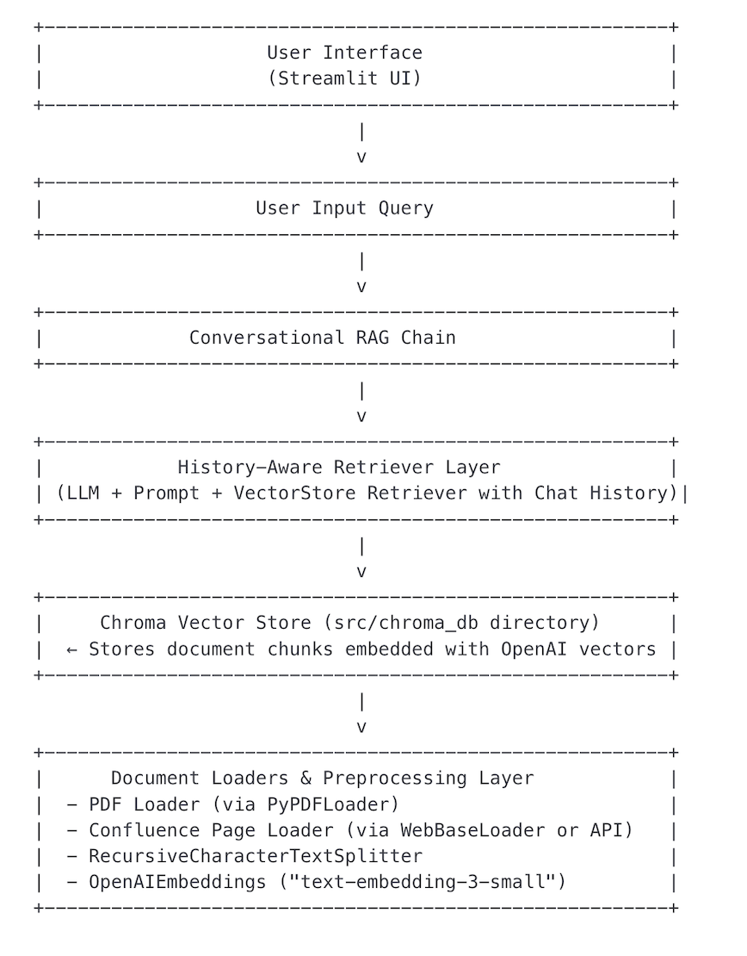
Data Flow Diagram

Slide 4
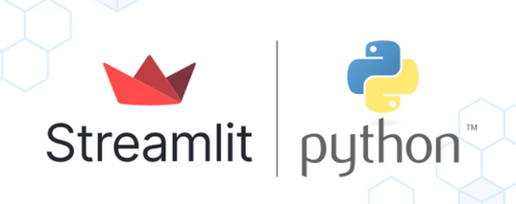
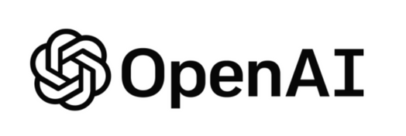


Tech Stack
COMPONENT | Tool/Library
VectorDB | ChromaDB
Embedding Model | OpenAI embedding model: text-embedding-3-small
LLM | OpenAI’s: gpt-4.1-mini
UI | Streamlit
File Parsing | PyMuPDF,pandas,python-docx

Slide 5
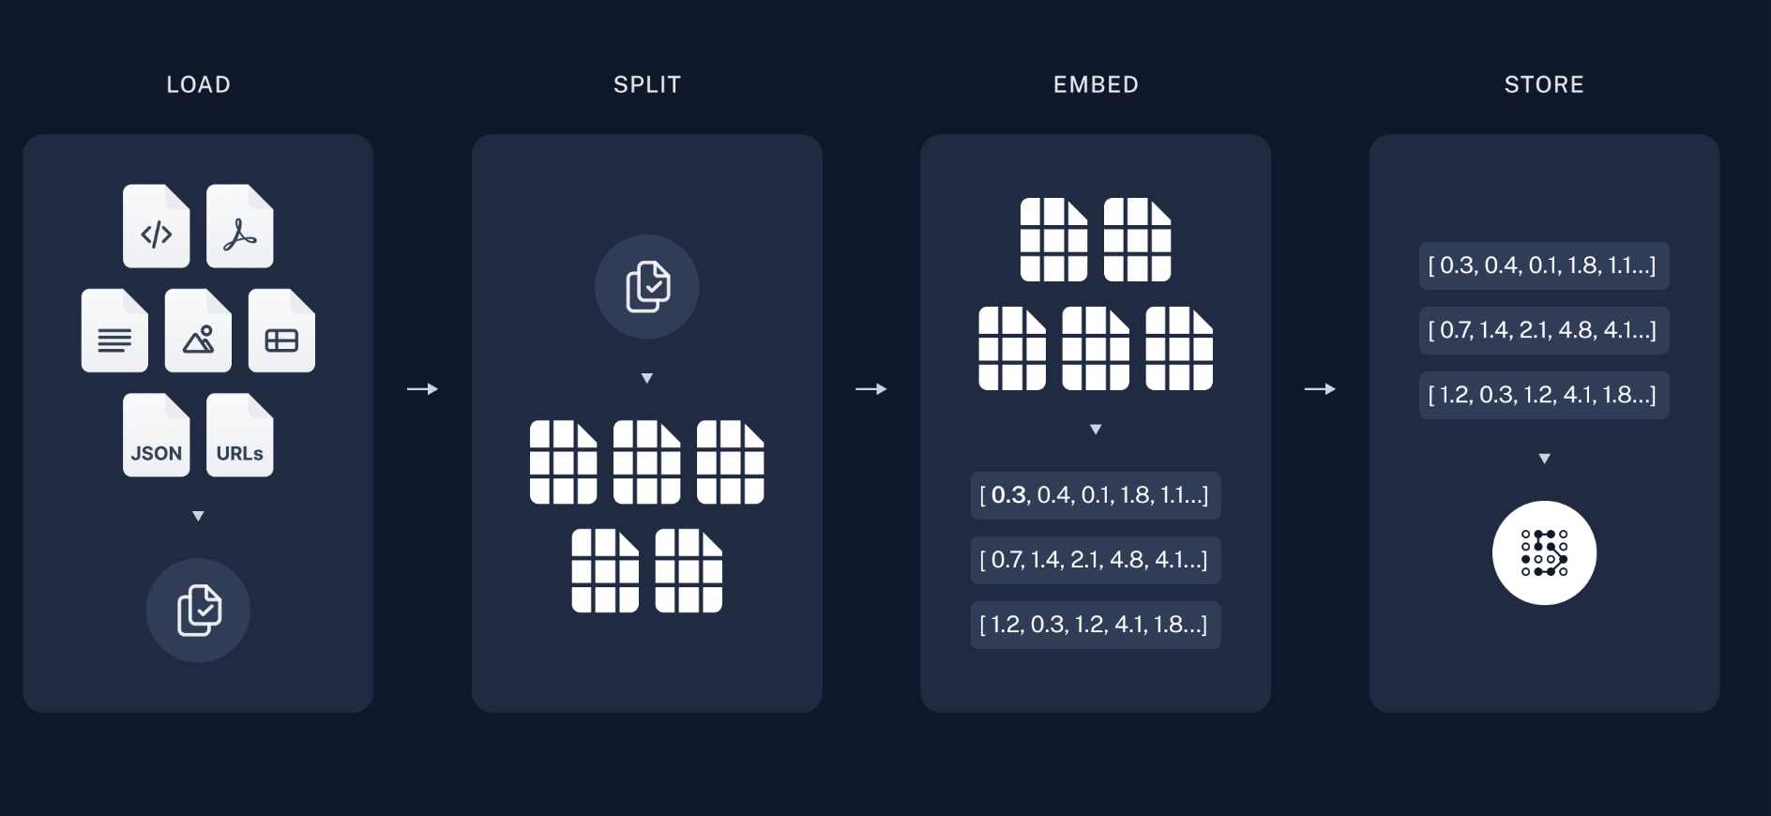
Text splitting and embedding

Slide 6
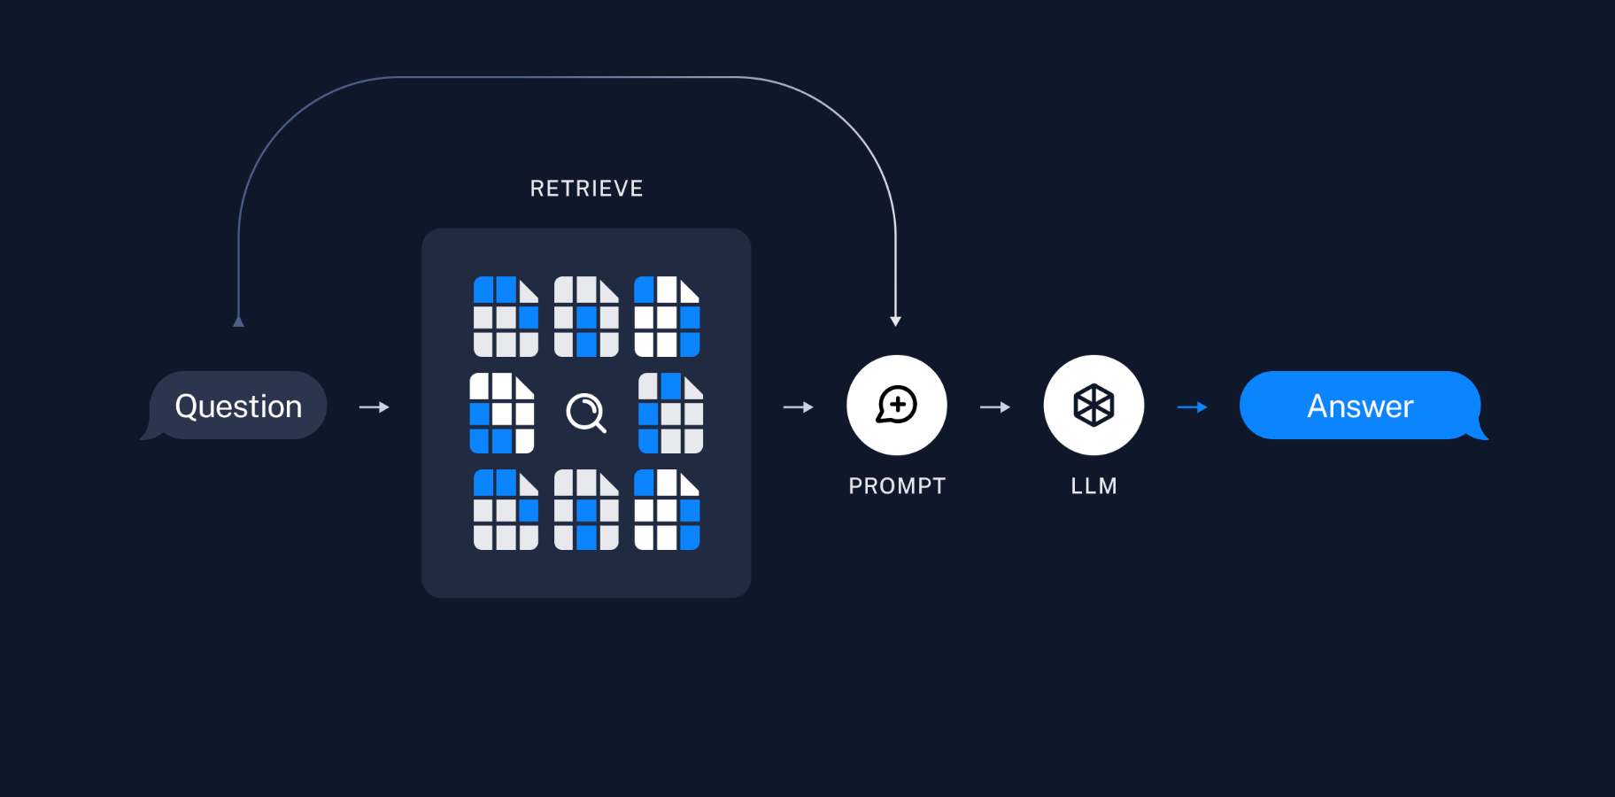
Retrieval and Generation

Slide 7
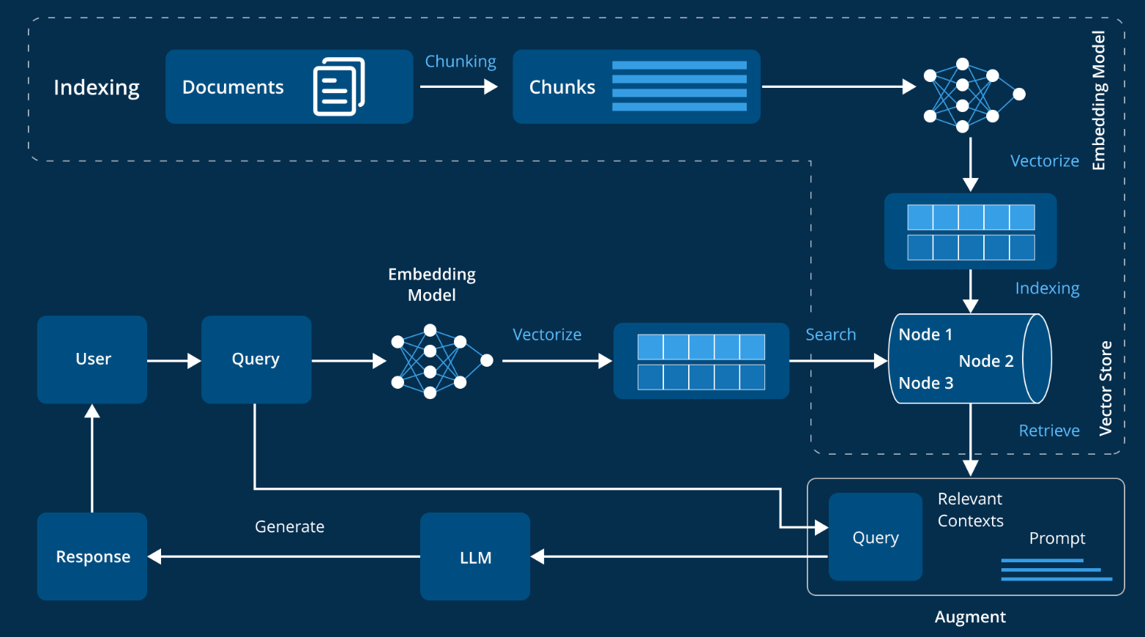
Architecture diagram
Documents formats:
PDF’s
DOCX
XLSX

Slide 8

Future Scope
Splunk Logs Agentic AI : It reads the logs find the error and try to find the solution.
ServiceNow Agentic AI: It reads the service now tickets, it try to match similar issue and provide the info teams to engage and resolution steps/ summary.
Codebase Agentic AI: It reads the code, creates the workflow steps into RAG documentation, it can generate workflow diagram as well

Slide 9
Thank you
Phanindra
Vineet
Sathvik
Ramesh
Nitish

